Slide 1
UNIT 2: Process Managenment

Slide 2
Unit 2: Process Management
Process Management: Process Concept
Process Scheduling
Process Scheduling - Basic Concepts,
Scheduling Criteria,
Scheduling Algorithms.
The Process : Understanding the process, How a process is created, login shell, init, internal and external commands, ps.

Slide 3
Objectives
To introduce the notion of a process -- a program in execution, which forms the basis of all computation
To describe the various features of processes, including scheduling, creation and termination, and communication

Slide 4
Process Concept
An operating system executes a variety of programs:
  Batch system – jobs
  Time-shared systems – user programs or tasks
Textbook uses the terms job and process almost interchangeably
Process – a program in execution; process execution must progress in sequential fashion
Multiple parts
  The program code, also called text section
  Current activity including program counter, processor registers
  Stack containing temporary data
    Function parameters, return addresses, local variables
  Data section containing global variables
  Heap containing memory dynamically allocated during run time

Slide 5
Process Concept (Cont.)
Program is passive entity stored on disk (executable file), process is active
  Program becomes process when executable file loaded into memory
Execution of program started via GUI mouse clicks, command line entry of its name, etc
One program can be several processes
  Consider multiple users executing the same program

Slide 6

Process in Memory

Slide 7


As a process executes, it changes state
  new: The process is being created
  running: Instructions are being executed
  waiting: The process is waiting for some event to occur
  ready: The process is waiting to be assigned to a processor
  terminated: The process has finished execution
Diagram of Process State

Slide 8


Information associated with each process
(also called task control block)
Process state – running, waiting, etc
Program counter – location of instruction to next execute
CPU registers – contents of all process-centric registers
CPU scheduling information- priorities, scheduling queue pointers
Memory-management information – memory allocated to the process
Accounting information – CPU used, clock time elapsed since start, time limits
I/O status information – I/O devices allocated to process, list of open files

Slide 9
Program counter :The counter indicates the address of the next instruction to be executed for this process.
• CPU registers : The registers vary in number and type, depending on the computer architecture. They include accumulators, index registers, stack pointers, and general-purpose registers, plus any condition-code information. Along with the program counter, this state information must be saved when an interrupt occurs, to allow the process to be continued correctly afterward (Figure 3.4).
• CPU-scheduling information.: This information includes a process priority, pointers to scheduling queues, and any other scheduling parameters. (Chapter 5 describes process scheduling.)
• Memory-management information :This information may include such information as the value of the base and limit registers, the page tables, or the segment tables, depending on the memory system used by the operating system (Chapter 8).
• Accounting information : This information includes the amount of CPU and real time used, time limits, account members, job or process numbers, and so on.
• I/O status information :This information includes the list of I/O devices allocated to the process, a list of open files, and so on.

Slide 10

CPU Switch From Process to Process

Slide 11
Threads
So far, process has a single thread of execution
Consider having multiple program counters per process
  Multiple locations can execute at once
    Multiple threads of control -> threads
For example, when a process is running a word-processor program, a single thread of instructions is being executed. This single thread of control allows the process to perform only one task at one time
Must then have storage for thread details, multiple program counters in PCB

Slide 12
Process Scheduling
Maximize CPU use, quickly switch processes onto CPU for time sharing
Process scheduler selects among available processes for next execution on CPU
Maintains scheduling queues of processes
  Job queue – set of all processes in the system
  Ready queue – set of all processes residing in main memory, ready and waiting to execute
  Device queues – set of processes waiting for an I/O device
  Processes migrate among the various queues

Slide 13

Ready Queue And Various I/O Device Queues

Slide 14

Representation of Process Scheduling
Queueing diagram represents queues, resources, flows
Figure 3.7

Slide 15
A common representation for a discussion of process scheduling is a
queueing diagram, such as that in Figure 3.7.
Each rectangular box represents a queue.
Two types of queues are present: the ready queue and a set of device queues.
The circles represent the resources that serve the queues,
and the arrows indicate the flow of processes in the system.
A new process is initially put in the ready queue. It waits there untill it is
selected for execution, or is dispatched. Once the process is allocated the CPU
and is executing, one of several events could occur:
• The process could issue an I/O request and then be placed in an I/O queue.
• The process could create a new sub process and wait for the sub process's
termination.
• The process could be removed forcibly from the CPU, as a result of an
interrupt, and be put back in the ready queue.
In the first two cases, the process eventually switches from the waiting state
to the ready state and is then put back in the ready queue.
A process continues this cycle until it terminates, at which time it is removed from all queues and has its PCB and resources deallocated.

Slide 16
Schedulers
A process migrates among the various scheduling queues throughout its lifetime. The operating system must select, for scheduling purposes, processes from these queues in some fashion.
There are three types of schedulers
Short-term scheduler (or CPU scheduler) – selects which process should be executed next and allocates CPU
  Sometimes the only scheduler in a system
  Short-term scheduler is invoked frequently (milliseconds) ⇒ (must be fast)
Long-term scheduler (or job scheduler) – selects which processes should be brought into the ready queue
  Long-term scheduler is invoked infrequently (seconds, minutes) ⇒ (may be slow)
  The long-term scheduler controls the degree of multiprogramming
Processes can be described as either:
  I/O-bound process – spends more time doing I/O than computations, many short CPU bursts
  CPU-bound process – spends more time doing computations; few very long CPU bursts
Long-term scheduler strives for good process mix

Slide 17
The long-term scheduler, or job scheduler, selects processes from this pool and loads them into memory for execution.
The short-term scheduler, or CPU scheduler, selects from among the processes that are ready to execute and allocates the CPU to one of them.
The primary distinction between these two schedulers lies in frequency of execution. The short-term scheduler must select a new process for the CPU frequently. A process may execute for only a few milliseconds before waiting for an I/O request. Often, the short-term scheduler executes at least once every 100 milliseconds. Because of the short time between executions, the short-term scheduler must be fast. If it takes 10 milliseconds to decide to execute a process for 100 milliseconds, then 10/(100 + 10) = 9 percent of the CPU is being used (wasted) simply for scheduling the work.
The long-term scheduler controls the degree of multiprogramming (the number of processes in memory). If the degree of multiprogramming is stable, then the average rate of process creation must be equal to the average departure rate of processes leaving the system. Thus, the long-term scheduler may need to be invoked only when a process leaves the system.

Slide 18

Addition of Medium Term Scheduling
Medium-term scheduler can be added if degree of multiple programming needs to decrease
The key idea behind a medium-term scheduler is that sometimes it can be advantageous to remove processes from memory (and from active contention for the CPU) and thus reduce the degree of multiprogramming. Later, the process can be reintroduced into memory, and its execution can be continued where it left off. This scheme is called swapping. The process is swapped out, and is later swapped in, by the medium-term scheduler.
  Remove process from memory, store on disk, bring back in from disk to continue execution: swapping

Slide 19
Context Switch
  When an interrupt occurs, the system needs to save the current context of the process currently running on the CPU so that it can restore that context when its processing is done, essentially suspending the process and then resuming it. The context is represented in the PCB of the process; it includes the value of the CPU registers, the process state (see Figure 3.2), and memory-management information.
  Switching the CPU to another process requires performing a state save of the current process and a state restore of a different process. This task is known as a context switch.
  When a context switch occurs, the kernel saves the context of the old process in its PCB and loads the saved context of the new process scheduled to run. Context-switch time is pure overhead, because the system does no useful work while switching.

Slide 20
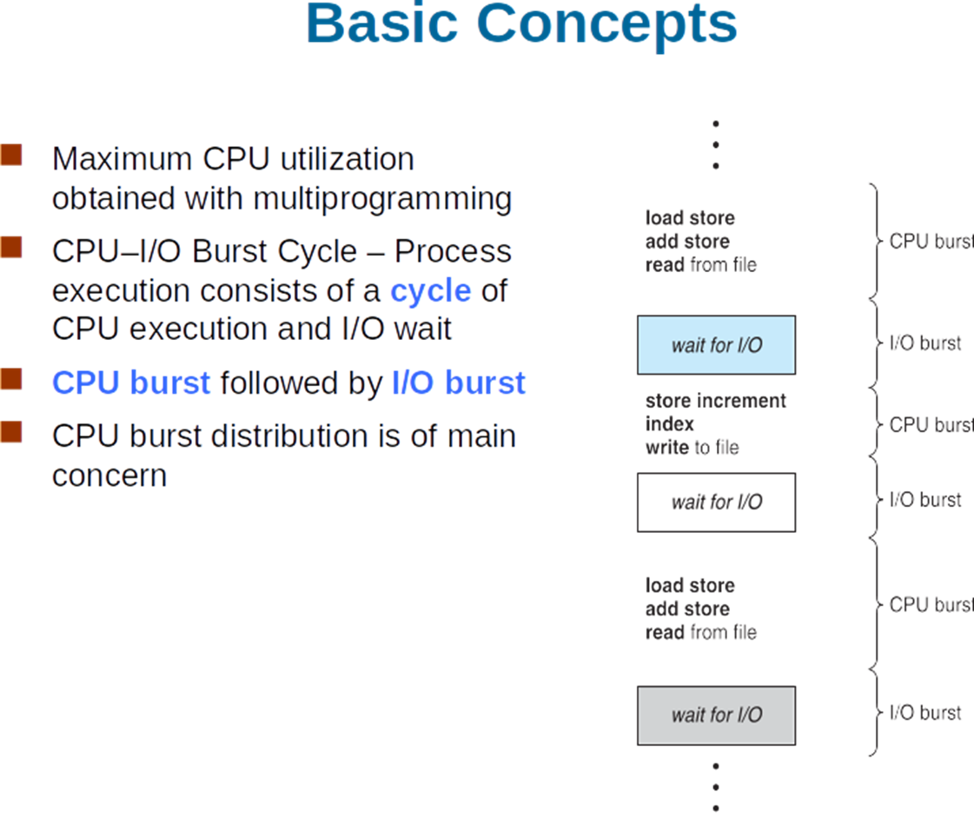

Slide 21
CPU Scheduler
Short-term scheduler selects from among the processes in ready queue, and allocates the CPU to one of them
  Queue may be ordered in various ways
CPU scheduling decisions may take place when a process:
  1. Switches from running to waiting state
  2. Switches from running to ready state
  3. Switches from waiting to ready
  Terminates
Scheduling under 1 and 4 is non preemptive
All other scheduling is preemptive
  Consider access to shared data
  Consider preemption while in kernel mode
  Consider interrupts occurring during crucial OS activities

Slide 22
Dispatcher
Dispatcher module gives control of the CPU to the process selected by the short-term scheduler; this involves:
  switching context
  switching to user mode
  jumping to the proper location in the user program to restart that program
Dispatch latency – time it takes for the dispatcher to stop one process and start another running

Slide 23
Scheduling Criteria
CPU utilization – keep the CPU as busy as possible
Throughput – # of processes that complete their execution per time unit
Turnaround time – amount of time to execute a particular process
Waiting time – amount of time a process has been waiting in the ready queue
Response time – amount of time it takes from when a request was submitted until the first response is produced, not output (for time-sharing environment)

Slide 24
Scheduling Algorithm Optimization Criteria
Max CPU utilization
Max throughput
Min turnaround time
Min waiting time
Min response time
Completion Time: Time at which process completes its execution.
Turn Around Time: Time Difference between completion time and arrival time. Turn Around Time = Completion Time – Arrival Time
Waiting Time(W.T): Time Difference between turn around time and burst time. Waiting Time = Turn Around Time – Burst Time

Slide 25
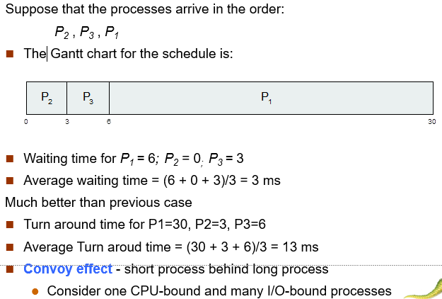
FCFS Scheduling (Cont.)

Slide 26
Shortest-Job-First (SJF) Scheduling
Associate with each process the length of its next CPU burst
  Use these lengths to schedule the process with the shortest time
SJF is optimal – gives minimum average waiting time for a given set of processes
  The difficulty is knowing the length of the next CPU request
  Could ask the user
SJF:
Out of all the available processes, CPU is assigned to the process having smallest burst time.
In case of a tie, it is broken by FCFS Scheduling.
SJF Scheduling can be used in both preemptive and non-preemptive mode.
Preemptive mode of Shortest Job First is called as Shortest Remaining Time First (SRTF).

Slide 27
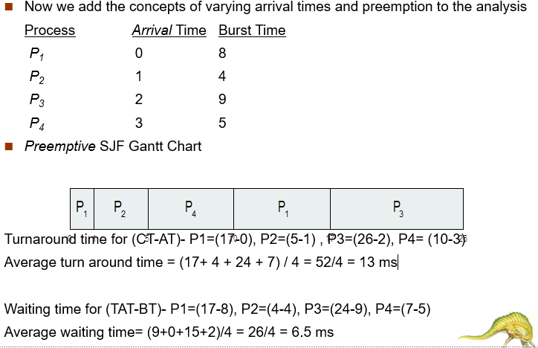
Example of Shortest-remaining-time-first

Slide 28
Priority Scheduling
A priority number (integer) is associated with each process
The CPU is allocated to the process with the highest priority (smallest integer ≡ highest priority)
  Preemptive
  Nonpreemptive
SJF is priority scheduling where priority is the inverse of predicted next CPU burst time
Problem ≡ Starvation – low priority processes may never execute
Solution ≡ Aging – as time progresses increase the priority of the process

Slide 29
Round Robin (RR)
Each process gets a small unit of CPU time (time quantum q), usually 10-100 milliseconds. After this time has elapsed, the process is preempted and added to the end of the ready queue.
If there are n processes in the ready queue and the time quantum is q, then each process gets 1/n of the CPU time in chunks of at most q time units at once. No process waits more than (n-1)q time units.
Timer interrupts every quantum to schedule next process
Performance
  q large ⇒ FIFO
  q small ⇒ q must be large with respect to context switch, otherwise overhead is too high

Slide 30

Time Quantum and Context Switch Time

Slide 31
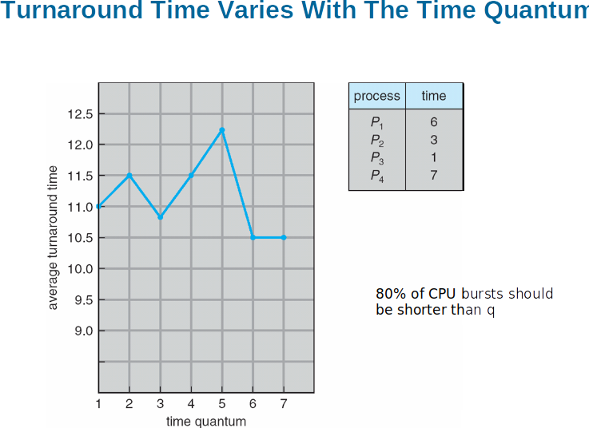

Slide 32
Multilevel Queue
Ready queue is partitioned into separate queues, eg:
  foreground (interactive)
  background (batch)
Process permanently in a given queue
Each queue has its own scheduling algorithm:
  foreground – RR
  background – FCFS
Scheduling must be done between the queues:
  Fixed priority scheduling; (i.e., serve all from foreground then from background). Possibility of starvation.
  Time slice – each queue gets a certain amount of CPU time which it can schedule amongst its processes; i.e., 80% to foreground in RR
  20% to background in FCFS

Slide 33

Multilevel Queue Scheduling

Slide 34
Multilevel Feedback Queue
A process can move between the various queues; aging can be implemented this way
Multilevel-feedback-queue scheduler defined by the following parameters:
  number of queues
  scheduling algorithms for each queue
  method used to determine when to upgrade a process
  method used to determine when to demote a process
  method used to determine which queue a process will enter when that process needs service

Slide 35

Example of Multilevel Feedback Queue
Three queues:
  Q₀ – RR with time quantum 8 milliseconds
  Q₁ – RR time quantum 16 milliseconds
  Q₂ – FCFS
Scheduling
  A new job enters queue Q₀ which is served FCFS
    When it gains CPU, job receives 8 milliseconds
    If it does not finish in 8 milliseconds, job is moved to queue Q₁
  At Q₁ job is again served FCFS and receives 16 additional milliseconds
    If it still does not complete, it is preempted and moved to queue Q₂

Slide 36
Find and fill the below given table for FCFS, SJF, Priority and RR (q=3)
Process Burst Priority
P1 8 4
P2 6 1
P3 1 2
P4 9 2
P5 3 3
Algorithm Avg Wait Avg TAT
FCFS
SJF
NonP Priority
RR

